Slide 1

Very low exposure simulator
Pralhad Yadwad
Lokesh Pandey
Aditya Phatak
Aryan Kamat
Nitish Pathak
Robin Jenkin | Ujwala Patil | March 2024

Slide 2
Worklet-Very low exposure simulator
Use Monte Carlo to generate very low-exposure images
Bulk processing of input distributions
INPUT: Luminance distribution image
OUTPUT: Low light distribution of photons as image
CONTEXT: Very low light levels can also affect the resolution of images as well as SNR as expected. This is designed to help investigate this phenomenon.

Slide 3
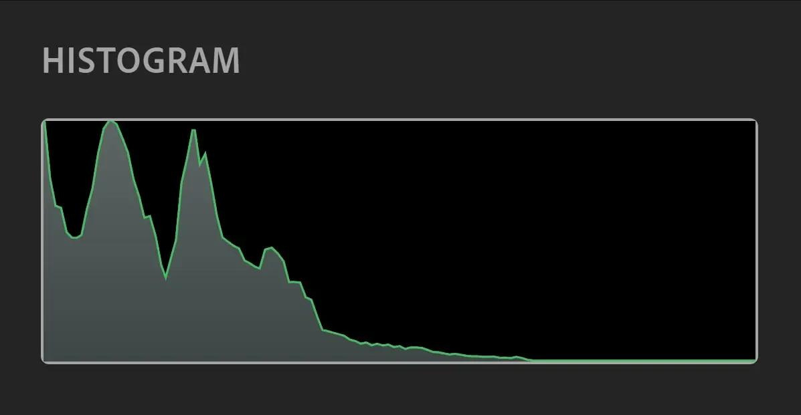
Our Thinking of the Proposed System
Selection of random photon samples using monte carlo simulation
transformation
Apertures Samples

Slide 4
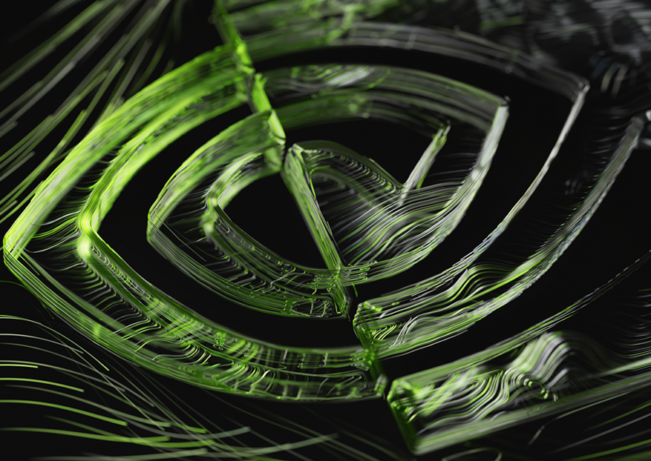
Our Sincere request
Is that sir if you could arrange a session on photometry and radiometry

